Slide 1

Chapter 2
DERIVATIVES

Slide 2
Contents
2.1. Derivatives
2.2. Differentiation Formulas
2.3.The chain rule
2.4. Implicit differentiation
2.5. Related Rates
2.6. Linear Approximations and Differentials
Notes:
The slope of tangent line as the limit of slopes of secant lines
Physical examples of instantaneous rates of change and their unit.
The derivative notation f’(a) and meaning of its.
Using f’ to write an equation of the tangent line to a curve at a given point.
Using f’ as an approximate rate of change when working with discrete data.

Slide 3
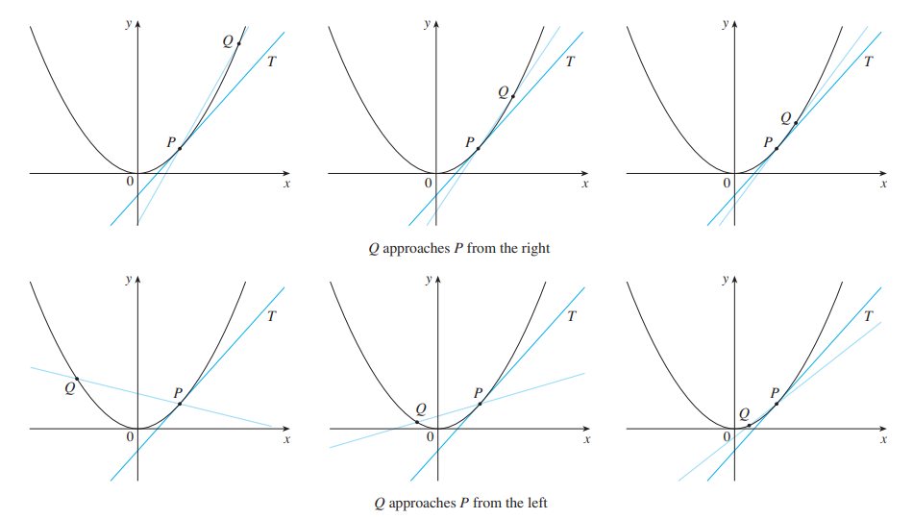
2.1 Derivatives
Notes:
The slope of tangent line as the limit of slopes of secant lines
Physical examples of instantaneous rates of change and their unit.
The derivative notation f’(a) and meaning of its.
Using f’ to write an equation of the tangent line to a curve at a given point.
Using f’ as an approximate rate of change when working with discrete data.

Slide 4
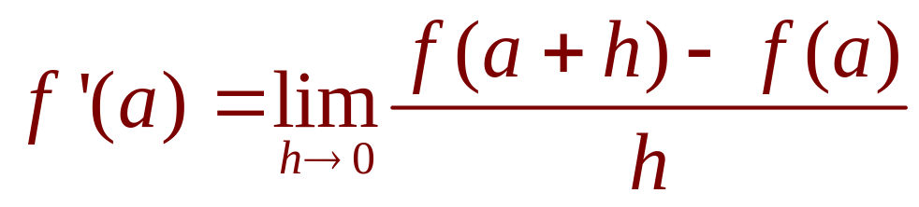
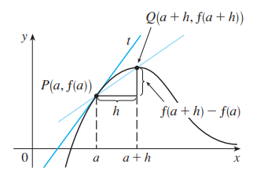
2.1 Derivatives
Definition
The derivative of a function f at a number a, denoted by
f’(a), is: if this limit
exists.
Notes:
Meaning of f’(a)?

Slide 5
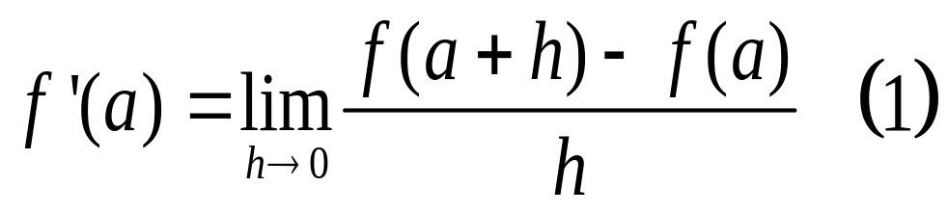

2.1 Derivatives
Definition
In the preceding section, we considered the derivative of a function f at a fixed number a:
If we replace a in Equation (1) by a variable x, we obtain:
Notes:
f‘(a) is a number; f’(x) is a function

Slide 6
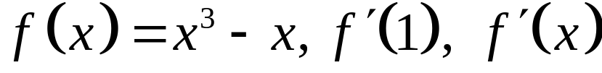
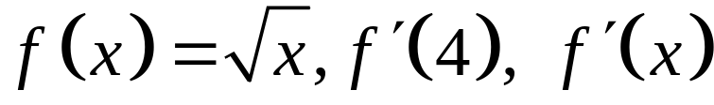
2.1 Derivatives
Example:
Using the definition of derivative, find the derivative of the functions:
a/
b/
Notes:
f‘(a) is a number; f’(x) is a function

Slide 7
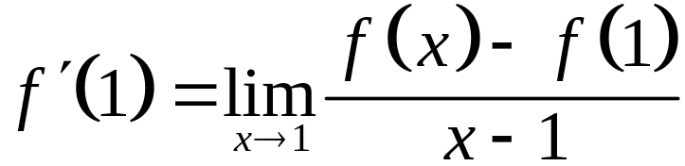
2.1 Derivatives
Solution:
a/ We have
Notes:
f‘(a) is a number; f’(x) is a function

Slide 8
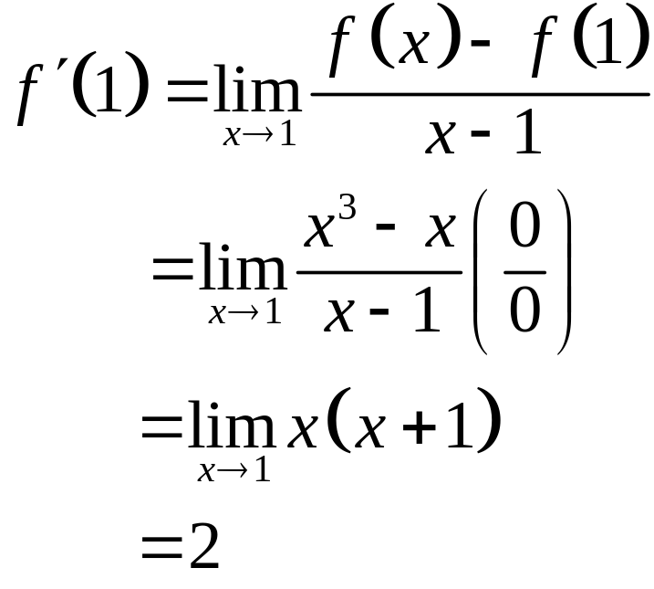
2.1 Derivatives
Solution:
a/ We have
Notes:
f‘(a) is a number; f’(x) is a function

Slide 9
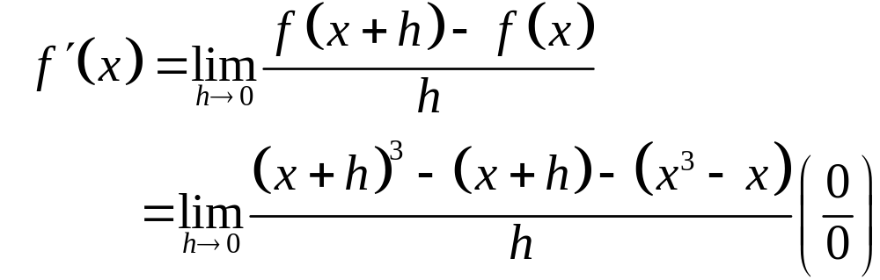
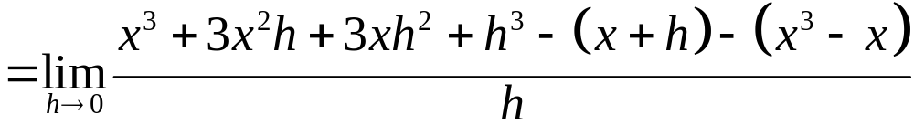
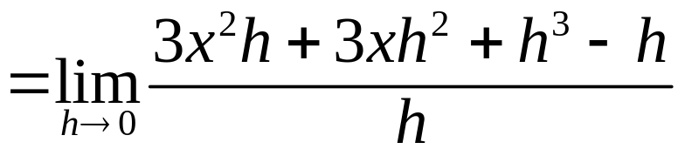
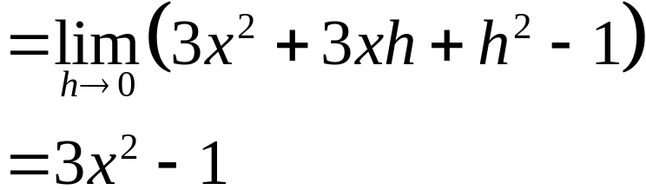
2.1 Derivatives
Solution:
a/
Notes:
f‘(a) is a number; f’(x) is a function

Slide 10
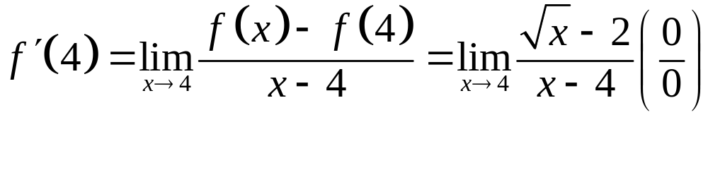
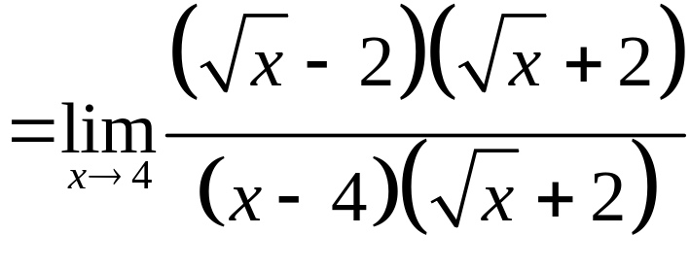
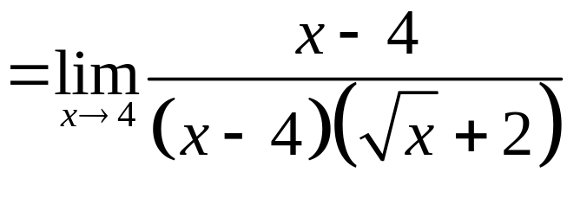
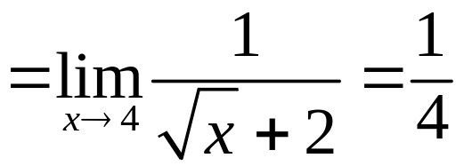
2.1 Derivatives
Solution:
b/ We have
Notes:
f‘(a) is a number; f’(x) is a function

Slide 11
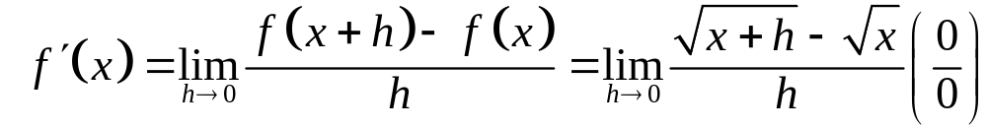
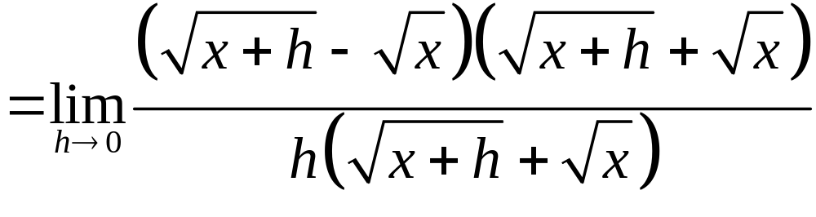
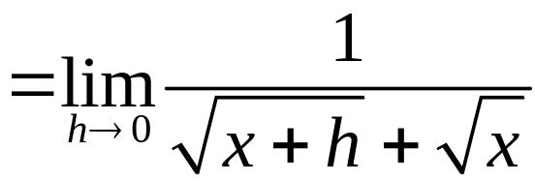
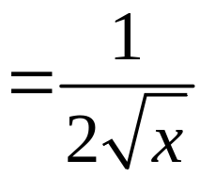
2.1 Derivatives
Solution:
b/
Notes:
f‘(a) is a number; f’(x) is a function

Slide 12
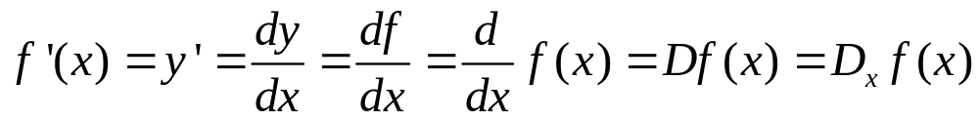

2.1 Derivatives
Other notations
Some common alternative notations for the derivative are as follows:
The symbols D and are called differentiation
operators.
The symbol dy/dx is called Leibniz notation

Slide 13
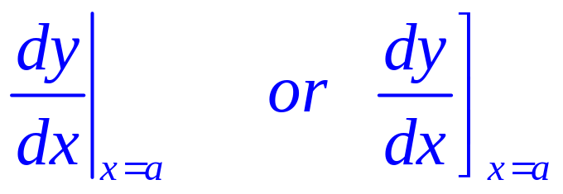
2.1 Derivatives
Other notations
If we want to indicate the value of a derivative dy/dx in Leibniz notation at a specific number a, we use the notation
which is a synonym for f’(a)

Slide 14
2.1 Derivatives
Theorem 1
A function f is differentiable at a if f’(a) exists.
It is differentiable on an open interval D if it is
differentiable at every number in the interval D.

Slide 15
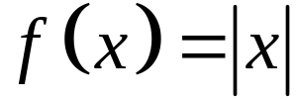

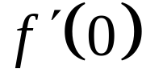
2.1 Derivatives
Theorem 2
is continous at but does’t exist.
If f is differentiable at a, then f is continuous at a.
This theorem states that, if f is not continuous at a, then f is not differentiable at a.
Example:
Notes:
f‘(a) is a number; f’(x) is a function

Slide 16
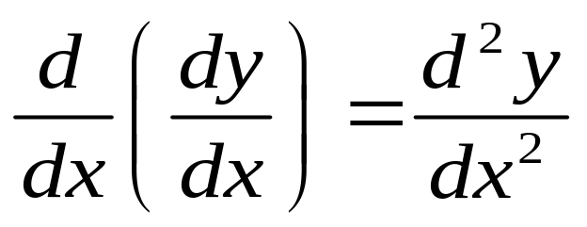
2.1 Derivatives
Higher derivatives
If f is a differentiable function, then its derivative f’ is also a function.
So, f’ may have a derivative of its own, denoted by
(f’)’= f’’.
This new function f’’ is called the second derivative of f.

Slide 17
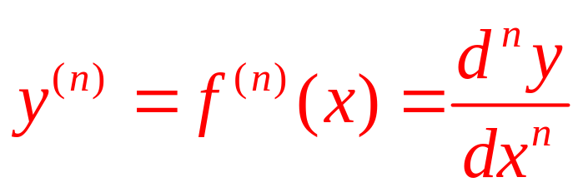
2.1 Derivatives
Higher derivatives
The process can be continued.
  In general, the nth derivative of f is denoted by f^{(n)} and is obtained from f by differentiating n times.
  If y = f(x), we write:

Slide 18
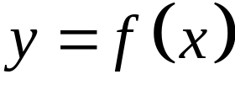
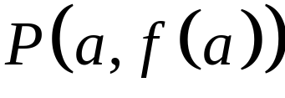
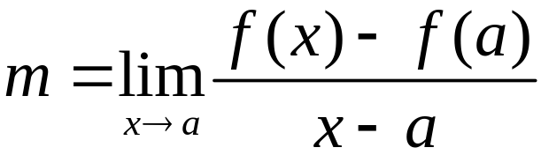
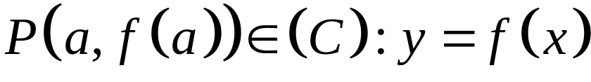
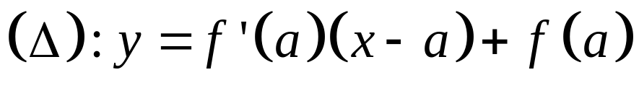
2.1 Derivatives
Tangent lines
The tangent line to the curve at the point
is the line through with slope provided that this limit exists
Tangent line (Δ) equation at
Notes:
f‘(a) is a number; f’(x) is a function

Slide 19
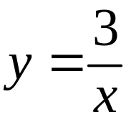
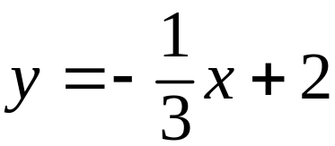
2.1 Derivatives
Tangent lines
Example:
Find an equation of the tangent line to the hyperbola
at the point (3,1).
Answer:

Slide 20

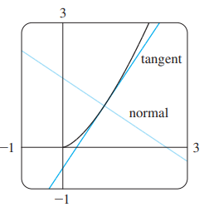
2.1 Derivatives
Normal lines
The normal line is defined as the line that is perpendicular to the tangent line at the point of tangency.
Notes:
The normal line is defined as the line that is perpendicular to the tangent line at the point of tangency.

Slide 21
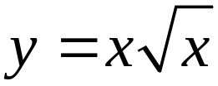
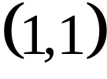
2.1 Derivatives
Normal lines
Example:
Find equations of the tangent line and normal line to the curve at the point .
Notes:
The normal line is defined as the line that is perpendicular to the tangent line at the point of tangency.

Slide 22
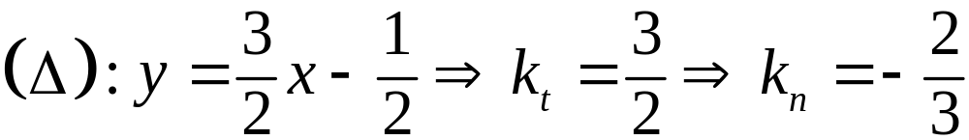
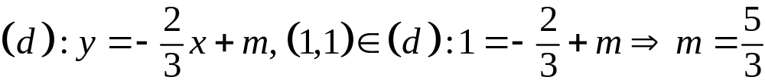
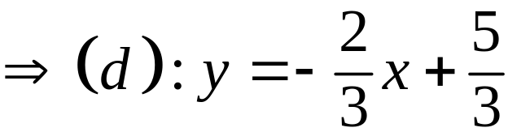
2.1 Derivatives
Normal lines
Solution:
Tangent:
Normal:
Notes:
The normal line is defined as the line that is perpendicular to the tangent line at the point of tangency.

Slide 23
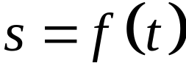

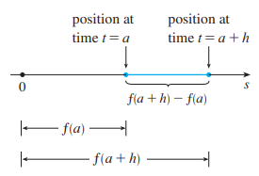
2.1 Derivatives
The velocity problem
In general, suppose an object moves along a straight line according to an equation of motion
Notes:
f‘(a) is a number; f’(x) is a function

Slide 24
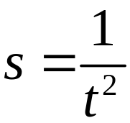

2.1 Derivatives
The velocity problem
Example
The displacement (in meters) of a particle moving in a straight line is given by the equation of motion , where is measured in seconds. Find the velocity of the par ticle at times
Notes:
f‘(a) is a number; f’(x) is a function

Slide 25
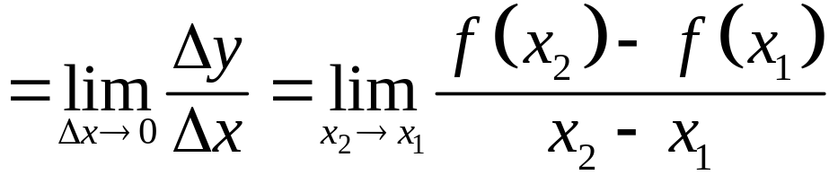


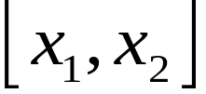
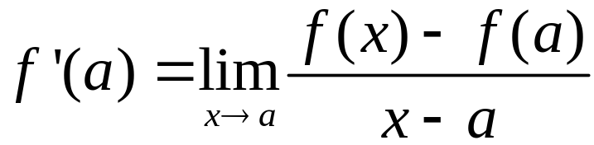

2.1 Derivatives
Rates of change:
instantaneous rate of change
Average of change of with respect to over the interval
is the instantaneous rate of change
of with respect to when
Notes:
is the instantaneous rate of change : tốc độ thay đổi tức thời

Slide 26
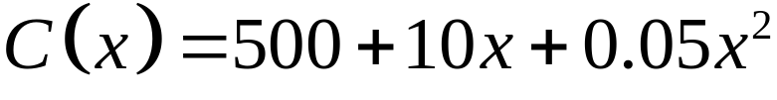
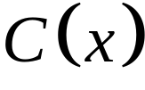




2.1 Derivatives
Rates of change:
Example
The cost (in dollars) of producing units of a certain commodity is
a/ Find the avegare of change of with respect to
when the production level is changed
i/ from to ii/ from to
b/ Find the instantaneous rate of change of with respect to when
Notes:
f‘(a) is a number; f’(x) is a function

Slide 27
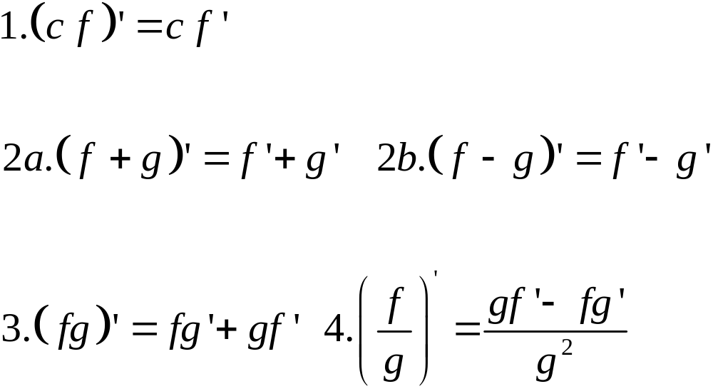
2.2. Differentiation formulas
Here’s a summary of the differentiation formulas we have learned so far.

Slide 28
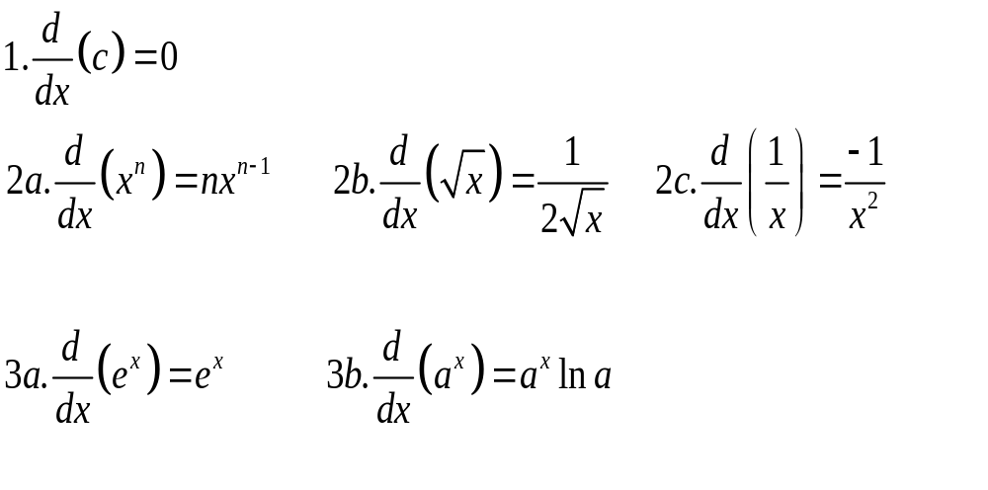
2.2. Differentiation formulas
Summary

Slide 29
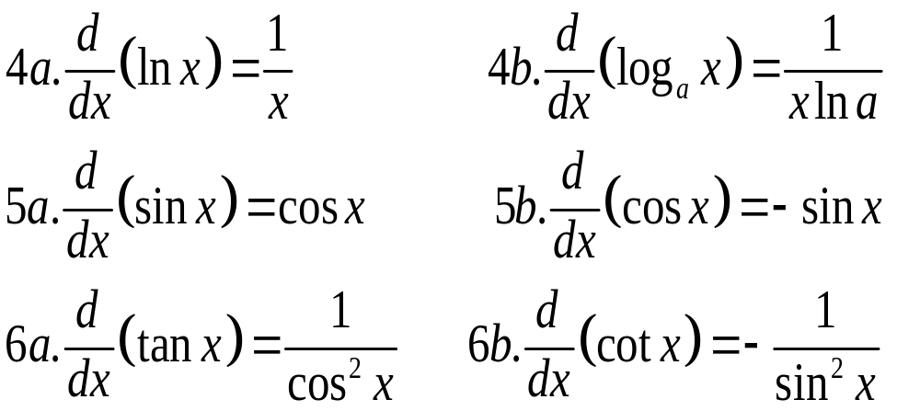
2.2. Differentiation formulas
Summary

Slide 30

2.2. Differentiation formulas
Review:

Slide 31





2.2. Differentiation formulas
Example:
Differentiate the function
a/ b/
c/ d/
e/
Notes:
f‘(a) is a number; f’(x) is a function

Slide 32




2.2. Differentiation formulas
Solution
a/
b/
Notes:
f‘(a) is a number; f’(x) is a function

Slide 33






2.2. Differentiation formulas
Solution
c/
d/
e/
Notes:
f‘(a) is a number; f’(x) is a function

Slide 34

2.3. The chain rule
If g is differentiable at x and f is differentiable at g(x), the
composite function h = f ◦ g is differentiable at x and h’ is
given by the product:
h’(x) = f’(g(x)) . g’(x)
  In Leibniz notation, if y = f(u) and u = g(x) are both
  differentiable functions, then:
Notes:
dy/dx is y’ dependent on x
dy/du is y’ dependent on u
du/dx is u’ dependent on x
“/” is not division.

Slide 35






2.3. The chain rule
Example 1:
Differentiate the function
a/ b/
c/ d/
e/ f/
Notes:
f‘(a) is a number; f’(x) is a function

Slide 36





2.3. The chain rule
Solution:
a/
b/
Notes:
f‘(a) is a number; f’(x) is a function

Slide 37






2.3. The chain rule
Solution:
c/
d/
Notes:
f‘(a) is a number; f’(x) is a function

Slide 38






2.3. The chain rule
Solution:
e/
Notes:
f‘(a) is a number; f’(x) is a function

Slide 39



2.3. The chain rule
Solution:
f/
Notes:
f‘(a) is a number; f’(x) is a function

Slide 40









2.3. The chain rule
Example 2:
Differentiate the function
a/ Let
If and find when
b/ Let
If find when
Notes:
f‘(a) is a number; f’(x) is a function

Slide 41







2.3. The chain rule
Solution:
a/ To differentiate, we need to use the Chain Rule:
Now we solve for the unknown quantity:
When
With we obtain
Similar, at we obtain
Notes:
f‘(a) is a number; f’(x) is a function

Slide 42





2.3. The chain rule
Solution:
b/ To differentiate, we need to use the Chain Rule:
Now we solve for the unknown quantity:
When
With we obtain
Similar, at we obtain
Notes:
f‘(a) is a number; f’(x) is a function

Slide 43

2.4. Implicit differentiation
The graphs of f and g are the upper and lower
semicircles of the circle x² + y² = 25.
Notes:
What is implicit function?
The technique of implicit differentiation

Slide 44

2.4. Implicit differentiation
The folium of Descartes
Notes:
What is implicit function?
The technique of implicit differentiation

Slide 45
2.4. Implicit differentiation
Instead, we can use the method of implicit differentiation.
This consists of differentiating both sides of the equation
with respect to x and then solving the resulting equation
for y’.

Slide 46


2.4. Implicit differentiation
a. If x² + y² = 25, find .
b. Find an equation of the tangent to the circle
x² + y² = 25 at the point .
Example 1:

Slide 47





2.4. Implicit differentiation
Solution:
a/ If x² + y² = 25, find .
Differentiating both sides of the equation with respect to x
Remembering that y is a function of x and using the Chain
Rule, we have:
Then, we solve this equation for :

Slide 48




2.4. Implicit differentiation
Solution:
b. At the , we have x = 3 and y = 4 or y = - 4
At
  Thus, an equation of the tangent to the circle at (3, 4)
  is: y – 4 = – ¾(x – 3) or 3x + 4y = 25.
  At
  Thus, an equation of the tangent to the circle at (3, 4)
  is: y + 4 = ¾(x – 3) or 3x - 4y = 25.

Slide 49
2.4. Implicit differentiation
Example 2
Find y’, y’’ if x⁴ + y⁴ = 16.

Slide 50

2.4. Implicit differentiation
Solution:
x⁴ + y⁴ = 16 (*)
Differentiating the equation implicitly (*) with respect to
x, we get: 4x³ + 4y³y’ = 0.
Solving for y’ gives:

Slide 51

2.4. Implicit differentiation
Solution:
To find y’’, we differentiate this expression for y’ using
the Quotient Rule and remembering that y is a function
of x:

Slide 52

2.4. Implicit differentiation
Solution:
If we now substitute into this expression, we get:

Slide 53

2.4. Implicit differentiation
Solution:
However, the values of x and y must satisfy the original
equation x⁴ + y⁴ = 16.
So, the answer simplifies to:

Slide 54
2.5. Related rates
The following steps in solving related rates problem:
1. Read the problem carefully.
2. Draw a diagram if possible.
3. Introduce notation. Assign symbols to all quantities that are functions of time.
4. Express the given information and the required rate in terms of derivatives.

Slide 55
2.5. Related rates
The following steps in solving related rates problem:
5. Write an equation that relates the various quantities of the problem. If necessary, use the geometry of the situation to eliminate one of the variables by substitution.
6. Use the Chain Rule to differentiate both sides of the equation with respect to .
7. Substitute the given information into the resulting equation and solve for the unknown rate.

Slide 56
2.5. Related rates
Example 1:
Air is being pumped into a spherical balloon so that its
volume increases at a rate of 100 cm³/s.
How fast is the radius of the balloon increasing when the
diameter is 50 cm ?

Slide 57




2.5. Related rates
Solution: Air is being pumped into a spherical balloon so
that its volume increases at a rate of 100 cm³/s.
How fast is the radius of the balloon increasing when the
diameter is 50 cm ?
Summary

Slide 58



2.5. Related rates
Solution:
  The radius of the balloon is increasing at the rate of
  1/(25π) ≈ 0.0127 cm/s.

Slide 59

2.5. Related rates
Example 2:
A ladder 10 ft long rests against a
vertical wall. If the bottom of the
ladder slides away from the wall
at a rate of 1 ft/s, how fast is the
top of the ladder sliding down the
wall when the bottom of the
ladder is 6 ft from the wall ?

Slide 60


2.5. Related rates
Example 2:
A ladder 10 ft long rests against a
vertical wall. If the bottom of the
ladder slides away from the wall
at a rate of 1 ft/s, how fast is the
top of the ladder sliding down the
wall when the bottom of the
ladder is 6 ft from the wall ?
Summary

Slide 61







2.5. Related rates
Solution:
Summary

Slide 62



2.5. Related rates
Solution:
  The fact that dy / dt is negative means that the distance
  from the top of the ladder to the ground is decreasing at a
  rate of ft/s.
  That is, the top of the ladder is sliding down the wall at a
  rate of ft/s.

Slide 63

2.5. Related rates
Example 3:
Each side of a square is increasing at a rate of 6 cm/s.
At what rate is the area of the square increasing when the
area of the square is ?
Notes:
Answer: 48 cm^2/s

Slide 64
2.5. Related rates
Example 4:
The length of a rectangle is increasing at a rate of 8 cm/s
and its width is increasing at a rate of 3 cm/s. When the
length is 20 cm and the width is 10 cm, how fast is the area
of the rectangle increasing ?
Notes:
Answer: 140 cm^2/s

Slide 65

2.5. Related rates
Example 5:
A cylindrical tank with radius 5 m is being filled with
water at a rate of . How fast is the height of the
water increasing ?

Slide 66

2.5. Related rates
Example 6:
A water tank has the shape of an inverted circular cone with
base radius 2 m and height 4 m. If water is being pumped
into the tank at a rate of 2 /min, find the rate at which the
water level is rising when the water is 3 m deep.

Slide 67

2.6.Linear Approximations and Differentials
Linear approximations:
We use the tangent line at (a, f(a)) as an approximation to the curve y = f(x) when x is near a. An equation of this tangent line is L(x) = y = f(a) + f’(a)(x - a).

Slide 68
2.6.Linear Approximations and Differentials
Linear approximations
The approximation
f(x) ≈ f(a) + f’(a)(x – a) = L(x)
is called the linear approximation of f at a.

Slide 69


2.6.Linear Approximations and Differentials
Linear approximations
Example 1:
Find the linearization of the function
at a = 1 and use it to approximate the numbers
Are these approximations overestimates or underestimates ?

Slide 70


2.6.Linear Approximations and Differentials
Linear approximations
Solution:

Slide 71


2.6.Linear Approximations and Differentials
Linear approximations
The corresponding linear approximation is:
(when x is near 1)
In particular, we have:

Slide 72

2.6.Linear Approximations and Differentials
Linear approximations
Look at the table and
the figure. The tangent
line approximation
gives good estimates
if x is close to 1.
However, the accuracy
decreases when x is
farther away from 1.

Slide 73





2.6.Linear Approximations and Differentials
Linear approximations
Example 2:
Use the linear approximation to of the function at a = 3 to approximate the numbers.
(Select the correct ones)
a) b)
c) d)

Slide 74
2.6.Linear Approximations and Differentials
Differentials
Example
The radius of a sphere was measured and found to be 21 cm
with a possible error in measurement of at most 0.05 cm.
What is the maximum error in using this value of the radius
to compute the volume of the sphere ?

Slide 75
2.6.Linear Approximations and Differentials
Differentials
Solution: If the radius of the sphere is r, then its volume is
V = 4/3πr³. If the error in the measured value of r is denoted by dr = ∆r, then the corresponding error in the calculated value of V is ∆V. This can be approximated by the differential
dV = 4πr²dr
When r = 21 and dr = 0.05, this becomes:
dV = 4π(21)² 0.05 ≈ 277
  The maximum error in the calculated volume is about 277 cm³.

Slide 76

2.6.Linear Approximations and Differentials
Differentials
Solution:
Relative error is computed by dividing the error by the total volume:
  Thus, the relative error in the volume is about three times
  the relative error in the radius.

Slide 77
2.6.Linear Approximations and Differentials
Differentials
Solution:
In the example, the relative error in the radius is
approximately dr/r = 0.05/21 ≈ 0.0024 and it produces a
relative error of about 0.007 in the volume.
  The errors could also be expressed as percentage errors of
  0.24% in the radius and 0.7% in the volume.

